Slide 1
Ocean
A Meeting Application
Notes:
Dhruv

Slide 2
Table of Contents
Refresher
Project story
Project plan
Input from other groups
Demo
MVP discussion
Next MVP
Team Reflection
Notes:
Dhruv

Slide 3
Refresher
Who we are: Bryden Trakalo, Hayden Jin, Dhruv Modi, Ziwen Tan
Our project idea: A application to connect two users together and create meetings between one another
Our team roles/responsibilities: Bryden / Hayden - Backend developers. Dhruv / Ziwen - Frontend developers. Everyone took responsibility as project manager
Notes:
Everyone

Slide 4
Project story
Initial why, what, who
WHY
Social interaction and group dynamics are a critical part of human society
Covid-19 has substantially impacted the amount and quality of social interactions that occur as people have been social distancing
This has had negative consequences as depression and suicide rates have hit all time highs
We want to encourage people to start making more friends and start being more social as this benefits individuals and the health of society as a whole
WHAT
A meeting application to connect users to each other and build lasting relationships
WHO
People who want to become more socially active
Notes:
Dhruv
An application designed to connect users to new people. It will take your interests, location, and age as inputs and output other users with similar interests within restraints of distance and age

Slide 5
Project plan
Discuss our kanban board
Discuss your team's project design architecture
Notes:
Dhurv kanban board

Slide 6
Envisioned MVPs
Interface to display information
Database to store information on users and meetings
Meeting system
Log out and log in functionality
Notes:
Bryden

Slide 7
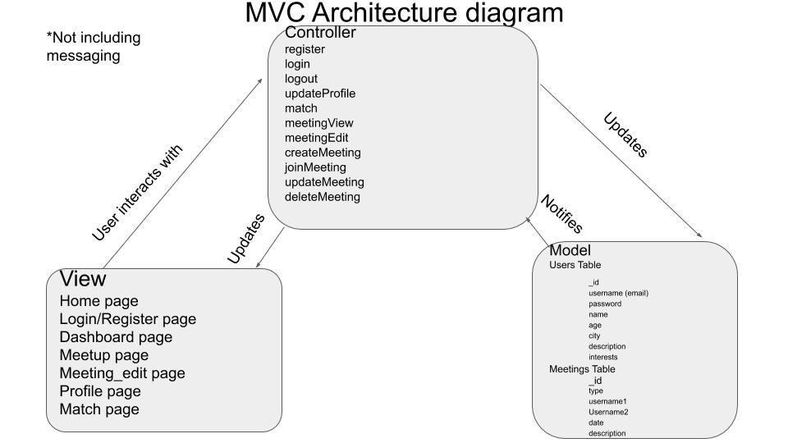
Notes:
bryden

Slide 8
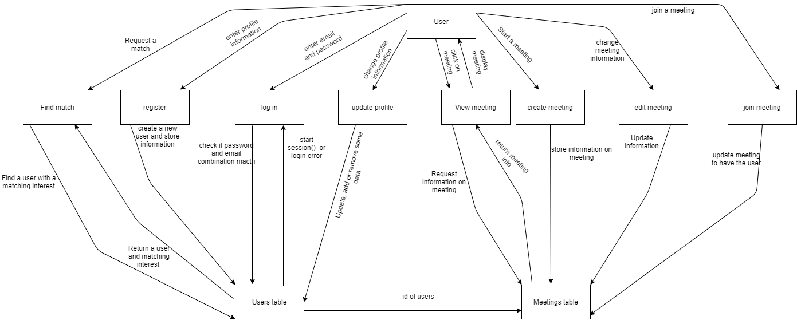
Data flow
Notes:
rbyden

Slide 9
Input from other groups
As a result of input from other groups during activity 4, we have made the following changes:
The app is more suited to building new friendships and meeting new people
The users are encouraged to talk and meet online at first and can decide if and when they want to participate in an in person activity
We would like to include the ability to have multiple user meetings but that is outside of our MVP scope as of right now
Notes:
Hayden will talk for this slide

Slide 10
Demo of product
Notes:
Bryden

Slide 11
MVP discussion
What makes it an MVP?
What is the team happy with?
Notes:
Bryden
Interface to display information, information to be stored in a database,, Meeting system to connect users, Log out and log in functionality.

Slide 12
What does the team think could potentially be better (if anything), does what the team envision for a next MVP still jive well?
Functionality to send messages between users
Leave a meeting (not just delete)
A calendar to display meetings
Dating functionality
Photos functionality
Add many users to a meeting
Privacy options (request to join meeting, request to view profile)
Notes:
Bryden

Slide 13
Team reflection
How did you feel about this project? Do you think your team was successful, or? What did you like about the project? What did you dislike about the project?
What did your team feel most proud of throughout the entire project experience?
What did you learn about yourself as you collaborated and worked on this project (individually and as a team)
How will you use (or not use) what you have learned/experienced in this project going forward?
What "stuff & things" related to this project would you like more help with?
Notes:
Ziwen will talk for this slide
Our next steps would be to make our application run on a server, open for anyone to access and use. Going from localhost to an actual IP address and domain name.

Slide 14
Team reflection
1.In this project, the most important thing is group push management. Although there were many problems in the process, they were eventually solved. Finally, this project was completed. I think the style and functionality of the project are very pleasing.
2. I think the proudest thing is that We have completed a functional APP, this is a good start for us.
3.What I have learned in this project is that we need to keep learning and master a language. And keep in contact with the team, to solve the problem more quickly.
4.In this project, I learned to cooperate with others, which I think is very important in my future work.
5.There isn't anything related to the project that we needed help with

Slide 15
Thank You

